Slide 1
Firms in a Competitive Market
9
Notes:
Pre-class music: “Takin’ Care of Business” by Bachman–Turner Overdrive (see Tip #325)
This song is a good introduction to employment, as Bachman–Turner Overdrive sings about the morning rush hour routine for those who work 9-to-5 jobs. The other key concepts covered by this song are competition and joblessness.

Slide 2
Previously—1
Economists break cost into explicit costs and implicit costs, and consider economic profit.
Marginal cost plays the most crucial role in a firm’s cost structure.
The MC curve always leads (pulls) the ATC and AVC curves.

Slide 3
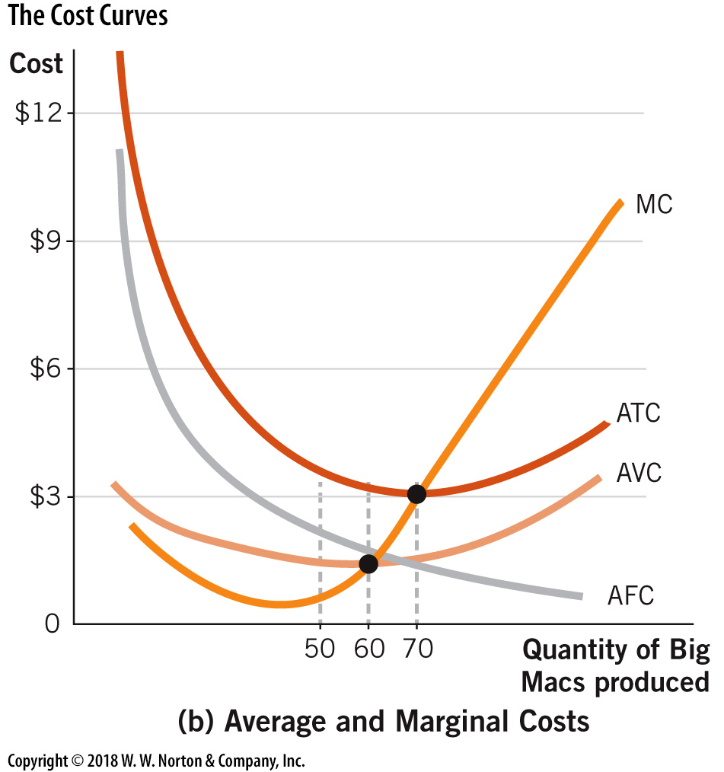
Average Cost Curves and Marginal Cost
Notes:
Image: Figure 8.2B
Lecture tip:
It may be helpful to do a quick review of the cost curve diagram before getting into this chapter. Review the following points:
Diminishing returns and U-shaped MC curve
MC intersects AVC and ATC at minimum
Marginal leads average

Slide 4
Previously—2
Economists break cost into explicit costs and implicit costs, and consider economic profit.
Marginal cost plays the most crucial role in a firm’s cost structure.
The MC curve always leads the ATC and AVC curves.
Scale economies determine long-run costs.
Notes:
Lecture notes:
When you get to the last point on the slide, review why long-run costs initially fall as scale increases and eventually increase as scale gets very large.

Slide 5
Big Questions
How do competitive markets work?
How do firms maximize profits?
What does the supply curve look like in perfectly competitive markets?

Slide 6

Competitive Markets
Competitive markets
  Many buyers and sellers
  Similar goods
  Firms are price takers
  Free entry and exit
Notes:
Lecture notes:
Price taker:
A firm that takes the market price as given, which is determined from the overall supply and demand conditions in the market
Point out that “price taking” is a result of many buyers/sellers and identical goods.
Briefly explain the importance of free entry and exit and long run performance (i.e., in long run, economic profit is driven to zero).
Explain what it means to have “free exit.”
Perfect competition is an “ideal” model.
It will show that if the characteristics hold, total surplus in the market is maximized.
[Maren Caruso/Photodisc/Getty Images]

Slide 7
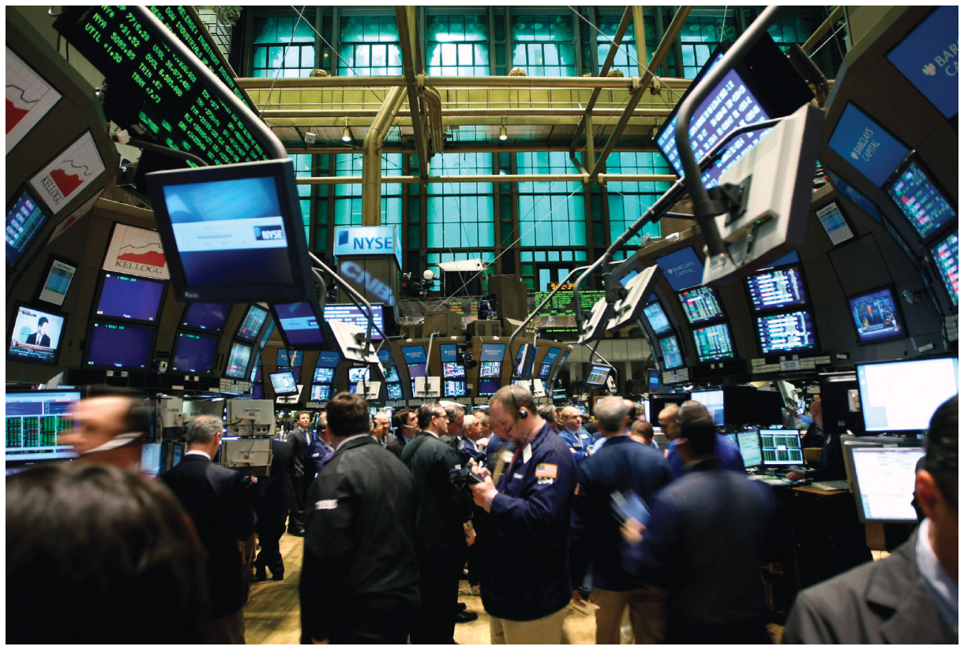

Are These Markets Really “Perfectly” Competitive?—1
Example | How It Works | Reality Check
Stock market | Millions of shares of stocks are traded daily. Buyers and sellers have access to real-time information. Most of the traders represent only a small share of the market, so they have little ability to influence the market price. | Large institutional investors are big enough to be able to influence the market price.
Farmers’ markets | Sellers are able to set up at little or no cost. There are many buyers and sellers of similar products, which causes the market price for similar products to converge toward a single price. | Many product markets do not have enough sellers to achieve a perfectly competitive result. With fewer vendors, individual sellers can often set higher prices.
Notes:
Lecture notes:
What aspects of the market make them competitive? Why do they fall short of the ideal perfectly competitive model?
Although it is not discussed directly in the textbook, there is an assumption of perfect information.
On farmers’ markets:
My farmers’ market has numerous zucchini sellers, but only one seller of Meow Milk, an unpasteurized milk that you can’t legally sell for human consumption, so you buy it for your “cat.”
[stock exchange: Neilson Barnard/iStockphoto.com; market: © Manon Ringuette | Dreamstime.com]

Slide 8
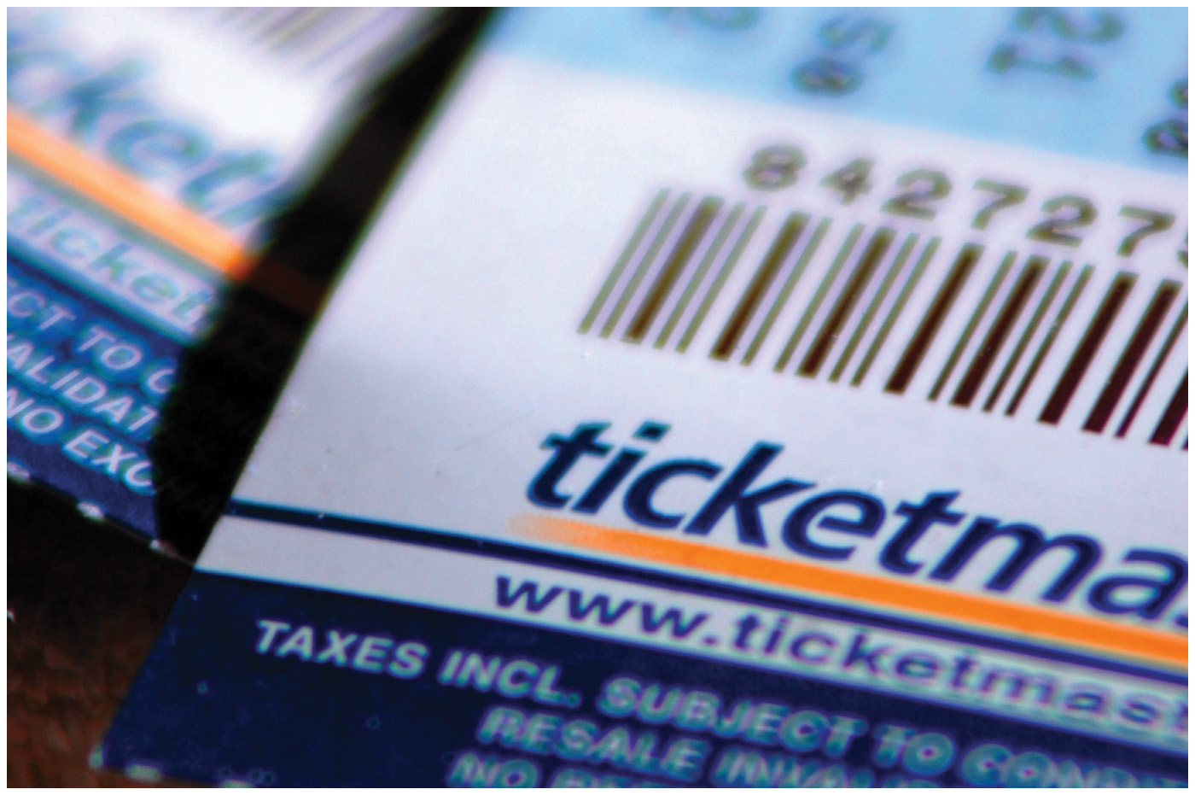

Are These Markets Really “Perfectly” Competitive?—2
Example | How It Works | Reality Check
Online ticket auctions | The resale market for tickets to major events involves many buyers and sellers. The prices for seats in identical sections end up converging quickly to a narrow range. | Some ticket companies and fans get special privileges that enable them to buy and sell blocks of tickets before others can enter the market.
Currency trading | Hundreds of thousands of traders around the globe engage in currency buying and selling on any given day. Because all traders have very good real-time information, currency trades in different parts of the world converge toward the same price. | Currency markets are subject to intervention on the part of governments that might wish to strategically alter the prevailing price of their currency.
Notes:
Lecture notes:
On online tickets:
If you are able purchase tickets earlier, you can buy large blocks and scalp them later.
You might want to ask students if they think scalping is efficient.
On currency trading:
Chinese Yuan pegged to the U.S. dollar.
[tickets: © Raine Vara / Alamy; currency: © Russell Shively/iStockphoto.com]

Slide 9
Economics in South Park, “Gnomes”
Harbucks moves into town, creating dire effects on the local coffee shop.
Notes:
“Economics in the Media” Slide
Lecture tip:
The clip mentioned on the slide can be found in the Interactive Instructor’s Guide. Access the direct link by clicking the icon in the PowerPoint above.
Please note that there are two other clips following this slide – it might be a good idea to split these clips up throughout your lecture, rather than showing them all at once.
This clip provides a good example of the nature of competition.
The other key concepts covered in this clip are:
Substitutes
Market power
Competition
Monopolistic competition
Barriers to entry
The firm

Slide 10
Economics in Two and a Half Men, “Dead from the Waist Down”
Alan tries to earn money by entering the competitive industry of personal massage.
Notes:
“Economics in the Media” Slide
Lecture tip:
The clip mentioned on the slide can be found in the Interactive Instructor’s Guide. Access the direct link by clicking the icon in the PowerPoint above.
This clip provides an example of how price is forced down to marginal cost in competitive markets.
The other key concepts covered by this clip are:
The firm
Competitive markets
Law of one price
Supply and demand

Slide 11
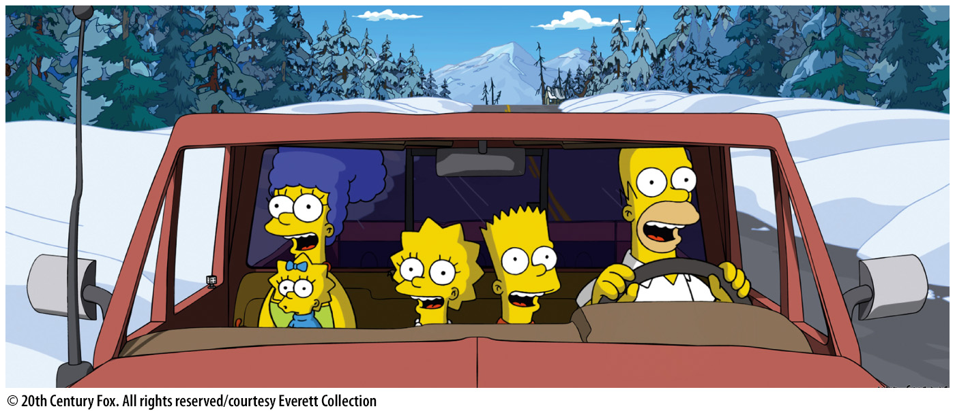
Economics in The Simpsons, “Mr. Plow”
Homer buys a snow plow and goes into the snow removal business.
Notes:
“Economics in the Media” Slide
Lecture tip:
The clip mentioned on the slide can be found in the Interactive Instructor’s Guide. Access the direct link by clicking the icon in the PowerPoint above.
The key concept covered in this clip is competitive markets.
You can follow up the clip by asking students:
How is the snow plowing market competitive?
[© 20th Century Fox. All rights reserved/courtesy Everett Collection]

Slide 12

How Do Firms Maximize Profits?
How many driveways should Mr. Plow clear to maximize profits?
Want to derive a firm’s
profit-maximizing rule
Notes:
Lecture tip:
Remind students that a competitive firm is a price taker—they take the market price as given and must decide quantity.
[© Chrisyates | Dreamstime.com]

Slide 13
Calculating Profits: Price = $10—1
Quantity | TR P × Q | TC | Profit TR – TC | MR Δ TR ÷ Δ Q | MC Δ TC ÷ Δ Q | Change in Profit MR – MC Δ TR ÷ Δ Q
0 | $0 | $25 | -$25
1 | 10 | 34 | -245 | $10 | $9 | 1
2 | 20 | 41 | -21 | 10 | 7 | 3
3 | 30 | 46 | -16 | 10 | 5 | 5
4 | 40 | 49 | -9 | 10 | 3 | 7
5 | 50 | 51 | -1 | 10 | 2 | 8
6 | 60 | 54 | 6 | 10 | 3 | 7
7 | 70 | 60 | 10 | 10 | 6 | 4
8 | 80 | 70 | 10 | 10 | 10 | 0
9 | 90 | 95 | -5 | 10 | 25 | -15
10 | 100 | 145 | -45 | 10 | 50 | -40
Notes:
Lecture tip:
Click through to make colored transparent rectangles appear. Explain each rectangle one at a time.
First click:
Blue rectangle: Shows TR = P x Q.
Second click:
Green rectangle: Shows Profit = TR – TC.
Ask students at what point profits are maximized.
Q = 7 or 8, and profit = $10.
Note that firms can’t use this approach since they learn profits after the fact, so we need a profit-maximizing rule.

Slide 14
Profit-Maximizing Rule—1
Mr. Plow wants to compare his marginal revenue to his marginal cost.
Marginal revenue (MR)
  MR = ΔTR ÷ ΔQ
Marginal cost (MC)
  MC = ΔTC ÷ ΔQ
Notes:
Lecture notes:
Recall that in economics, the optimal condition is often setting marginal something = marginal something else.
Marginal analysis:
We are looking at one output unit at a time and inspecting the costs and revenues associated with that one unit of output.

Slide 15
Profit-Maximizing Rule—2
Marginal profit
  Δ Profit = MR – MC
Profit-maximizing rule:
  Profit is maximized by choosing the level of output such that
  MR = MC
Notes:
Lecture notes:
Recall that in economics, the optimal condition is often setting marginal something = marginal something else.
Marginal analysis:
We are looking at one output unit at a time and inspecting the costs and revenues associated with that one unit of output.
MR never equals MC, so you want to continue producing Q as long as MR > MC.

Slide 16
Calculating Profits: Price = $10—2
Quantity | TR P × Q | TC | Profit TR – TC | MR Δ TR ÷ Δ Q | MC Δ TC ÷ Δ Q | Change in Profit MR – MC Δ TR ÷ Δ Q
0 | $0 | $25 | -$25
1 | 10 | 34 | -245 | $10 | $9 | 1
2 | 20 | 41 | -21 | 10 | 7 | 3
3 | 30 | 46 | -16 | 10 | 5 | 5
4 | 40 | 49 | -9 | 10 | 3 | 7
5 | 50 | 51 | -1 | 10 | 2 | 8
6 | 60 | 54 | 6 | 10 | 3 | 7
7 | 70 | 60 | 10 | 10 | 6 | 4
8 | 80 | 70 | 10 | 10 | 10 | 0
9 | 90 | 95 | -5 | 10 | 25 | -15
10 | 100 | 145 | -45 | 10 | 50 | -40
Notes:
Lecture tip:
Click through to make colored transparent rectangles appear. Explain each rectangle one at a time.
First click:
Shades in MR (green rectangle)
ΔTR = $10 and ΔQ = 1, so ΔMR = $10.
Note that this is just the price.
Second click:
Shades in MC (red rectangle)
ΔTC is not the same each time.
Ask students where the firm maximizes profits:
Q = 8, MR = MC = 10.
Ask students if there is another way of stating the MR = MC rule.
Marginal profit = 0
Third click:
Rectangle appears around the solution

Slide 17
Profit-Maximizing Rule—3
Profit is maximized by choosing the level of output such that
  MR = MC
What should the firm do if MR > MC?
What should the firm do if MR < MC?
Notes:
Lecture notes:
Where does MR = MC come from? Ask students to think about the intuition of producing one more unit.
If MR >MC for producing one more unit, you could increase profit by producing more.
If MC > MR for producing one more unit, doing so will decrease profits.
Therefore, maximize profits where MR = MC.

Slide 18
Deciding How Much to Produce
Mr. Plow will maximize profits where MR = MC.
Since he is a price taker: P* = MR.
Notes:
Lecture tip:
You could note here that another way of stating the profit max rule for perfect competition is P* = MC.

Slide 19
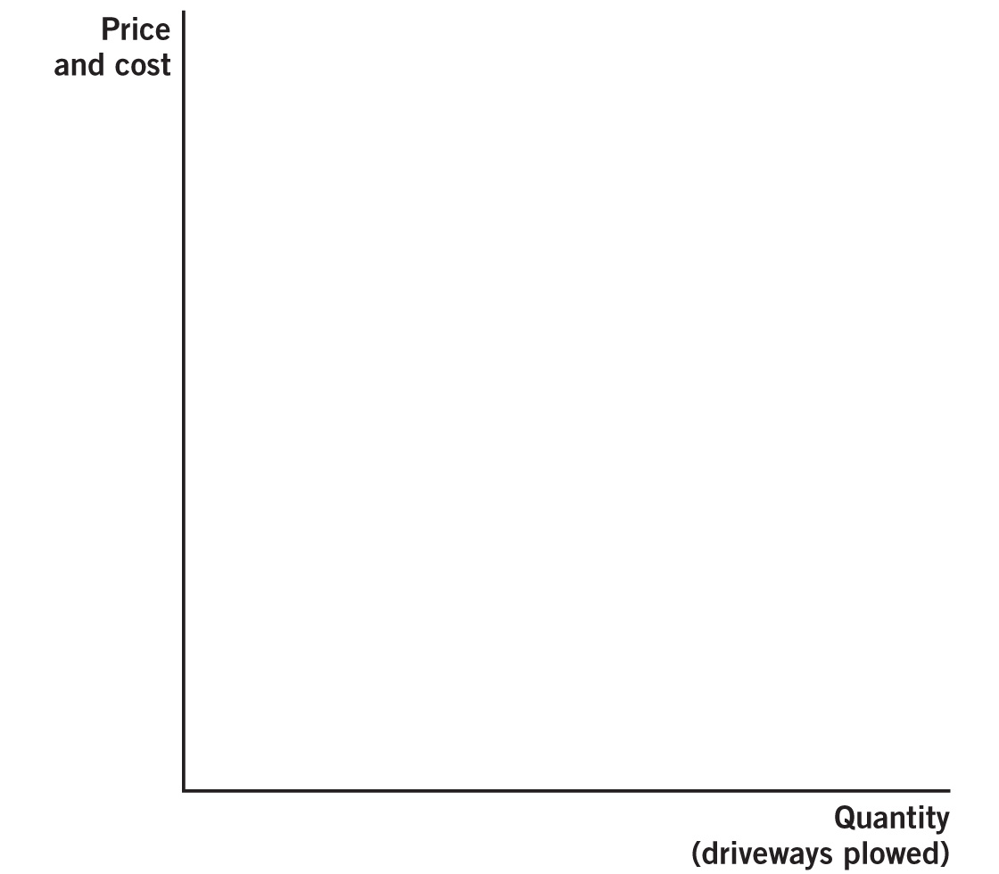
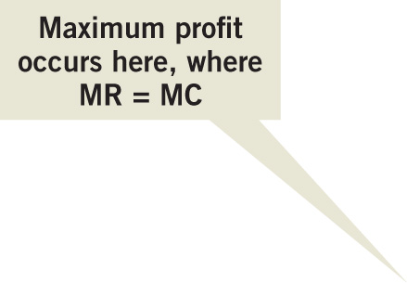
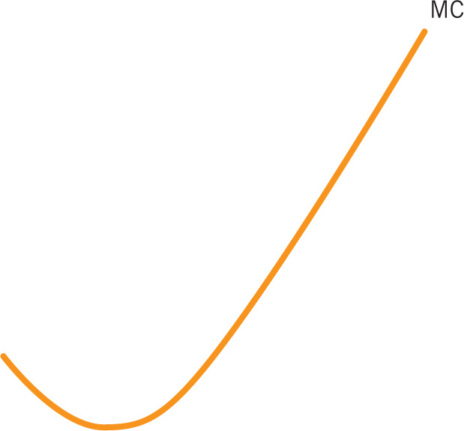
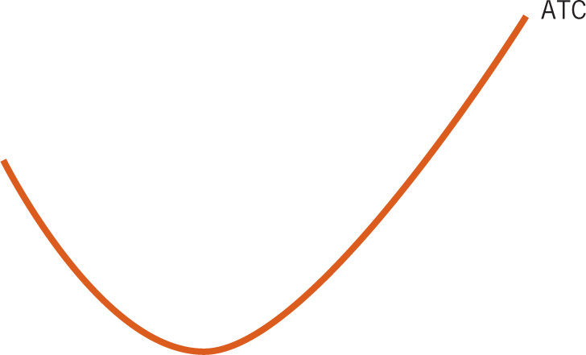

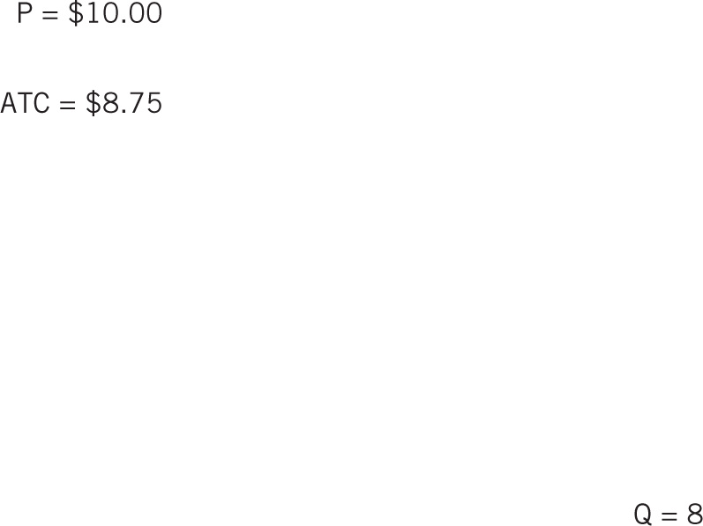

Profit Maximization
Notes:
Image: Animated Figure 9.1
Lecture notes:
The figure starts out with firms’ cost curves.
Review U-shape (diminishing returns)—MC intersects at minimum point of ATC.
First click:
Draws P = MR = $10
Ask students how to show the profit maximizing output.
Second click:
Labels profit max output where P = MR = MC
Ask students whether the firm is making a profit. How do they know?
Third click:
Labels ATC = $8.75 for Q = 8
Fourth click:
Shades in green profit rectangle

Slide 20
How to Calculate Profit
Profit = (Price – Average Total Cost) x Q
  Π = ($10 – $8.75) x 8 = $10
Notes:
Lecture notes:
On the graph on the previous slide, the firm’s profit is shown as the area of a rectangle:
Q is the width of the rectangle (number of units sold).
P – ATC is the height of the rectangle (average profit per unit).

Slide 21
Class Activity: Think-Pair-Share
Suppose you are the owner of a firm producing jelly beans at the average cost per case in the table below.
Initially, you produce 200 cases of jelly beans per time period. Then, a new customer calls and places an order for a case, requiring you to increase your output to 201 cases. She offers you $350 for the case. Should you produce it?
CASES | AVERAGE COST
200 | $200
201 | $201
202 | $202
203 | $203
Notes:
Classroom activity: Think-Pair-Share: The Marginal Cost of Producing More Jelly Beans (see Tip #338)
Ask students to get into pairs to discuss the scenario above.
Then, discuss the following with the class as a whole:
With 200 cases, TC = $40,000
With 201 cases, TC = $40,401
MC of extra case = $401
Since $350 < $401, do not produce it.

Slide 22
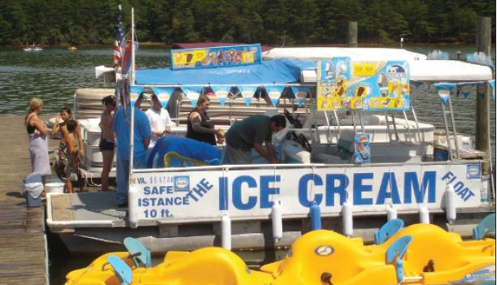
The Firm in the Short Run
Firms can’t always make a profit.
Shutting down:
  A firm will shut down if it cannot cover variable costs.
  Shutting down is not the same as going out of business and exiting the industry.
Notes:
Regarding the image on the slide: Ice Cream Float, which crisscrosses Smith Mountain Lake in Virginia
Lecture notes:
Another example that you could use in your lecture is:
Businesses and restaurants in West Yellowstone, Montana, are only open in the winter and summer when many tourists visit Yellowstone National Park. During the off seasons of fall and spring, the establishments shut down.
Emphasize that shutting down is NOT the same as going out of business.
Shutting down:
Firm doesn’t open today (or this week).
Lights stay off, workers stay home, and the assembly line switch doesn’t get turned on.
Zero output is produced.
However, if conditions improve (namely, higher prices for output), the option to “turn on” the business again is always possible.
Exiting the industry:
We completely get out.
We sell all our equipment, and workers no longer have jobs (and need to find jobs elsewhere).
I’m out of the industry.
[Courtesy of Dirk Mateer]

Slide 23
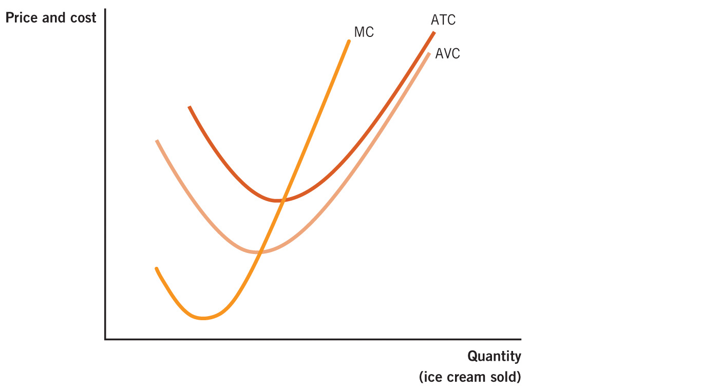






When to Operate or Shut Down
Notes:
Image: Animated Figure 9.2
Lecture notes:
The figure starts with the firm’s cost curves.
First click:
Labels min. point of ATC = $2.50 and AVC = $2.00
Second click:
Shades in area above min. ATC
If P is above the minimum point on the ATC curve, the firm will make a profit (shown in green).
Third click:
Shades in area between ATC and AVC
If P is below min. ATC but above min. AVC, the firm will operate at a loss (shown in yellow).
Fourth click:
Shades in area below min AVC
If MR curve is below the min. AVC curve, the firm will temporarily shut down (shown in red).

Slide 24
Profit and Loss in the Short Run
Condition | Outcome
P > ATC | The firm makes a profit
ATC > P > AVC | The firm will operate to minimize loss
AVC > P | The firm will temporarily shut down
Notes:
Lecture tip:
Explain to students why the firm will still stay open in the short run if it makes an economic loss.
Can cover variable costs and some of its fixed costs
If shut down, would lose all of its fixed costs
So, firm is better off staying open

Slide 25
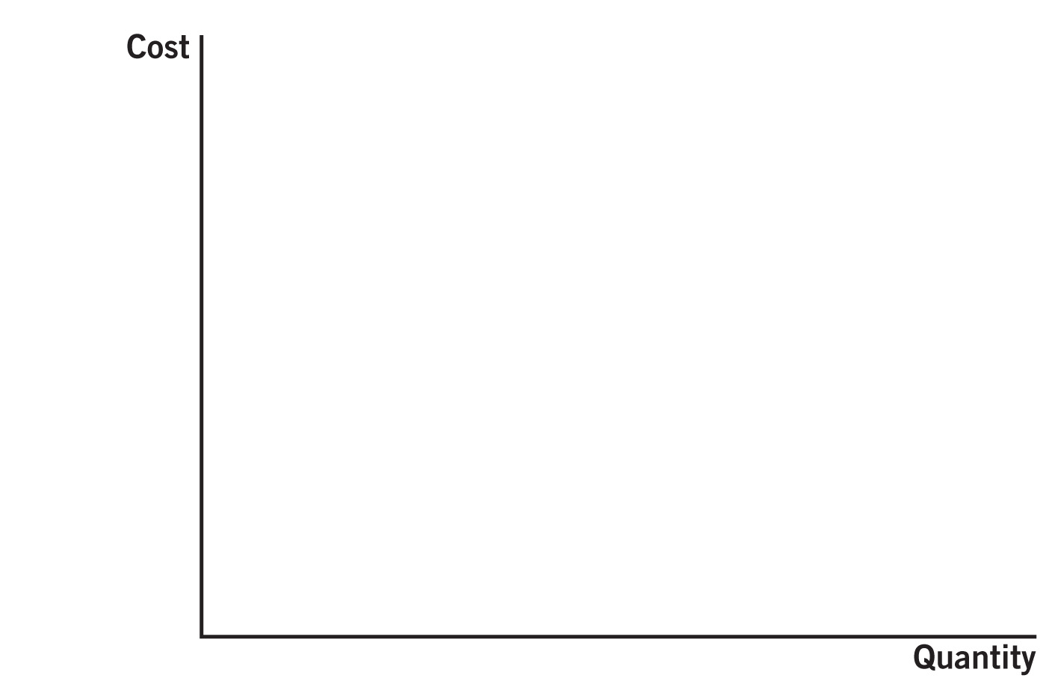
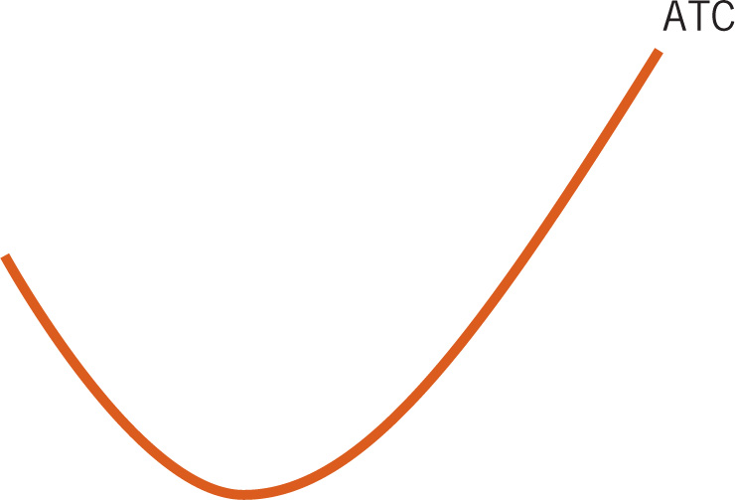
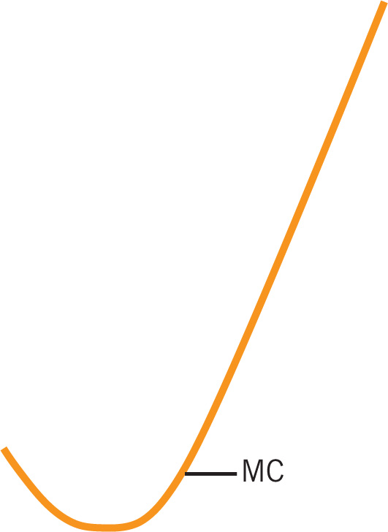
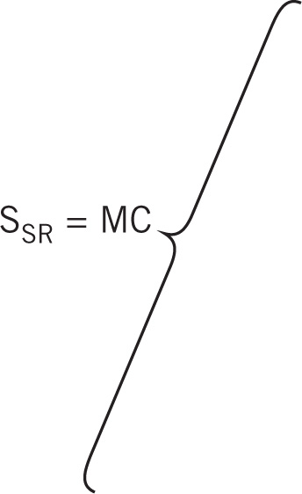

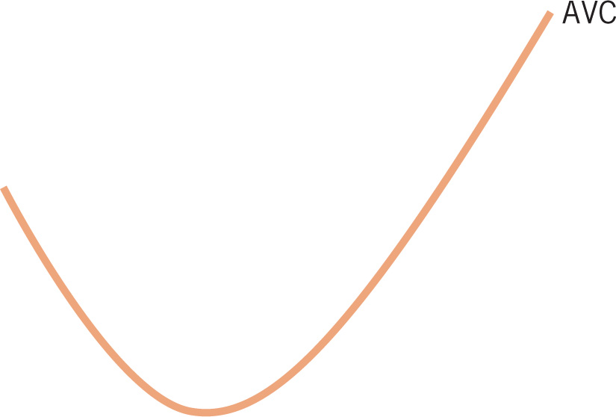


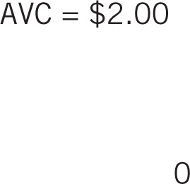

Short-Run Supply Curve
Notes:
Image: Animated Figure 9.3
Lecture notes:
We know that the firm will shut down if P < min. AVC (the red area) = $2.00, so Q = 0.
First click:
Draws the vertical portion of the supply curve
We know that if P > = min. AVC, the firm’s profit maximizing output is where MR = MC (yellow and green areas).
Second click:
Draws upward-sloping portion of the supply curve

Slide 26
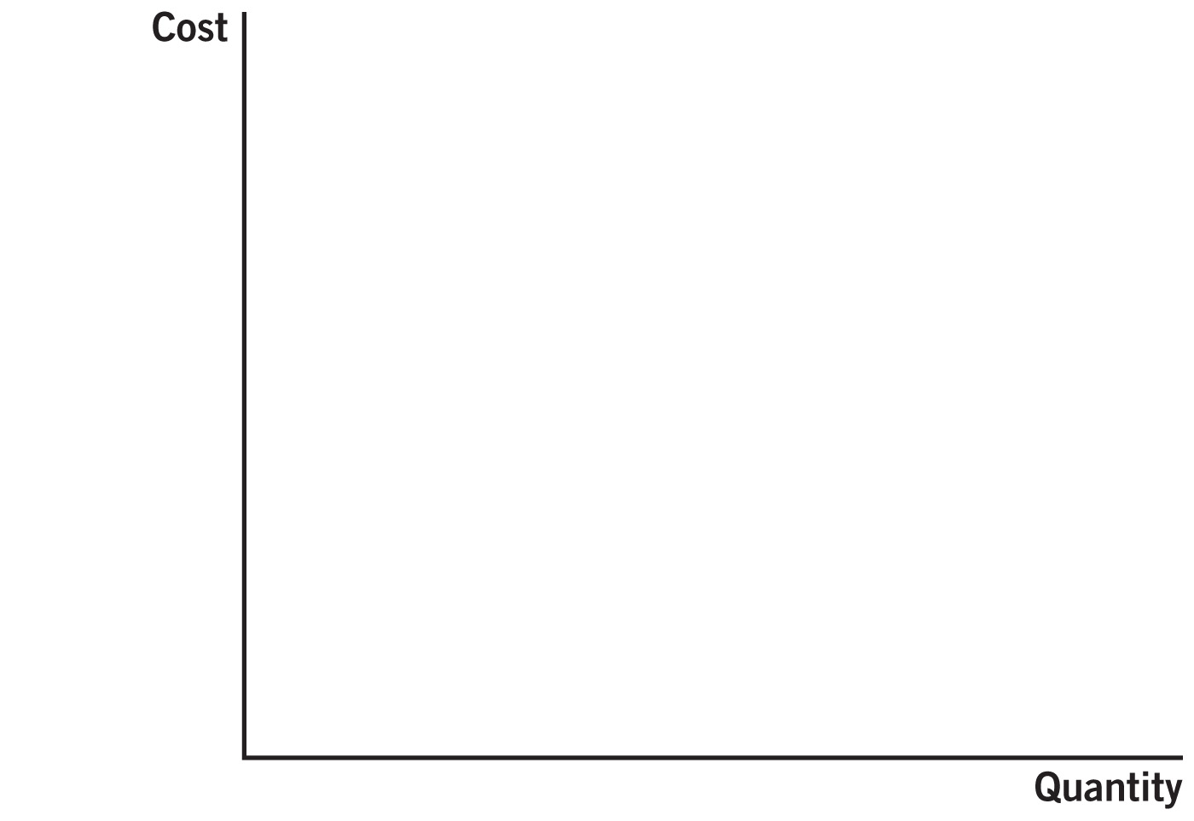
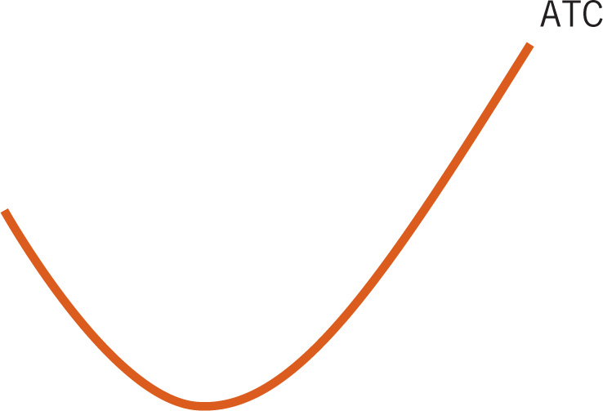
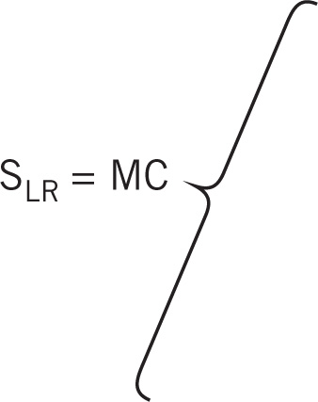
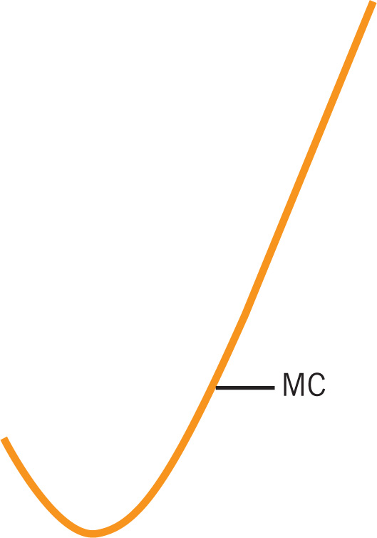

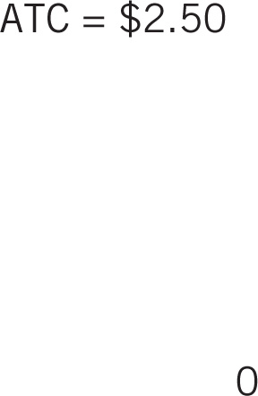


Long-Run Supply Curve
Notes:
Image: Animated Figure 9.4
Lecture notes:
In the long run, a firm will not operate if it cannot cover its total costs.
If P < min. ATC, Q = 0.
First click:
Draws the vertical portion of the supply curve
If P > = min. ATC, firm’s supply curve and MC curve are the same.
Second click:
Draws the upward-sloping portion of the MC curve
In the long run, all costs are variable costs.

Slide 27
Long-Run Shut Down Criteria
Condition | Outcome
P > ATC | The firm makes a profit
P < ATC | The firm should shut down
Notes:
Lecture notes:
Ask students what they think the firm should do if P = min. ATC.

Slide 28
Sunk Costs
Sunk costs
  Unrecoverable costs that have been incurred as a result of past decisions
Sunk-cost fallacy
  Considering sunk costs when making new decisions at the margin
Notes:
Lecture notes:
At this point, you could discuss the stadium story from the text:
Three Rivers Stadium in Pittsburgh and Veteran’s Stadium in Philadelphia were built in the early 1970s.
They were multiuse facilities for both football and baseball, each with an expected lifespan of 60 or more years.
Both were replaced after 2000.
Critics of new stadiums argued that demolishing old stadiums was a waste; they were thinking that sunk costs mattered.
But the new stadiums generated more revenue than the old stadiums did.
Correct analysis—compare:
Benefit of new stadium:
The additional revenue of the new stadium
Cost of demolishing old stadium plus the cost of constructing the new one
If benefits > costs, build the new stadium.

Slide 29
Economics in The Big Bang Theory, “The Einstein Approximation”
Leonard has a new ringtone—audio of a sinister laugh by the Joker from Batman.
Notes:
“Economics in the Media” Slide
Lecture tip:
The clip mentioned on the slide can be found in the Interactive Instructor’s Guide. Access the direct link by clicking the icon in the PowerPoint above.
The key concepts covered in this clip are:
Sunk cost
Irrational behavior
Follow up the clip by asking students: How does the clip illustrate the sunk-cost fallacy?

Slide 30
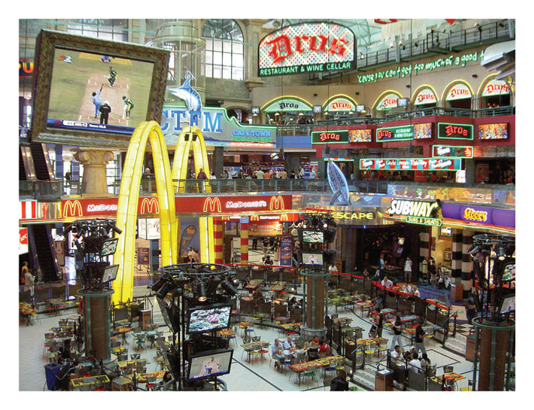
Sunk-Cost Fallacies in Your Life—1
You are waiting in a long line with your friend at one food court restaurant while there is no line at another.
  Your friend says, “We might as well stay in line. We've already been waiting for 15 minutes.”
Notes:
“Beyond the Book” Slide
This is an example of a sunk cost:
Since you can’t get that 15 minutes back, it is a sunk cost and you should not consider it when deciding whether to move to another line.
If you would be better off getting out of line and going to the empty restaurant, but the fact that you have already waited in line for 15 minutes is preventing you from switching, that IS the sunk-cost fallacy.
Be careful here, though.
If the MB (really good food) is greater than the MC of waiting in line (perhaps 20 MORE minutes), then staying in line is a good decision.
Therefore, this IS NOT an example of the sunk-cost fallacy.
[© 20th Century Fox. All rights reserved/courtesy Everett Collection]

Slide 31

Sunk-Cost Fallacies in Your Life—2
After one semester of college
  “I’m not getting much from my experience at Tech, but I’ve already spent time and money for a whole semester here, so I don’t want to transfer to State.”
Notes:
“Beyond the Book” Slide
Once again, you cannot get that semester back (time or money). If transferring to State is a good idea at the margin for the next four to five years, you should transfer, even if your credits from Tech don’t!
Other examples can include:
You are sitting in a bad movie but decide to stay since you have already paid $10 for a ticket.
At a breakfast buffet, some people say they will eat as much as they can since they want to get their money’s worth.
[© DreamWorks/Courtesy Everett Collection]

Slide 32
Practice What You Know—1
Steve runs a competitive sandwich shop. Right now, he is producing output at a level where MR > MC.
To increase his profits, Steve should
  try to use more capital in his production.
  try to use more labor in his production.
  produce less output.
  produce more output.
Notes:
Clicker question
Correct answer: D, produce more output.
The marginal analysis says to produce until MR = MC. If MR > MC, it means you could be making more profits by making more sandwiches.

Slide 33
Practice What You Know—2
Suppose a competitive firm is faced with a price in the short run that is below ATC but above AVC. In the short run, this firm should
  shut down.
  exit the industry.
  raise the price of the good.
  produce at the output level where MR = MC.
Notes:
Clicker question
Correct answer: D, produce at the output level where MR = MC.
Here, the firm can cover all VC and part of FC (better to cover part of your FC than none of your FC).
Note that a competitive firm cannot raise the price because of the existence of perfect substitutes.

Slide 34
Practice What You Know—3
A competitive firm will shut down and produce output level Q = 0 if
  price < min. (ATC).
  min. (AVC) < price < min. (ATC).
  price < min. (AVC).
  P = MR.
Notes:
Clicker question:
Correct answer: C, Price < min. (AVC).
This answer is the “shut down point.” The minimum of the AVC gives us the boundary price of when it’s best to produce or shut down. If you can’t even cover your variable expenses, it is best to shut down.

Slide 35
The Perfectly Competitive Market Supply Curve
Our analysis so far has focused on a typical firm.
Now, we want to derive the market supply curve in the short run and long run.
Notes:
Lecture notes:
The main points here are:
A firm maximizes profits where MR = MC.
Since the firm is a price taker, P = MR.
But to determine price, we need to derive the market supply curve.

Slide 36
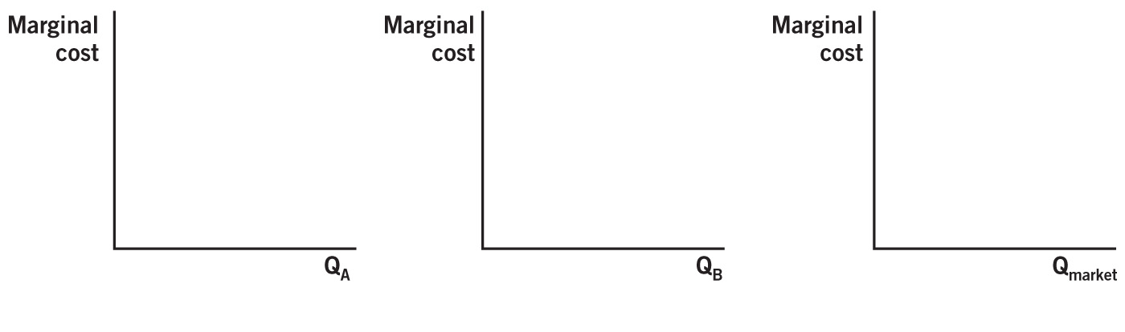

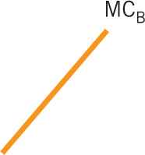


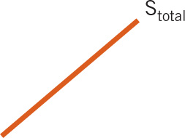
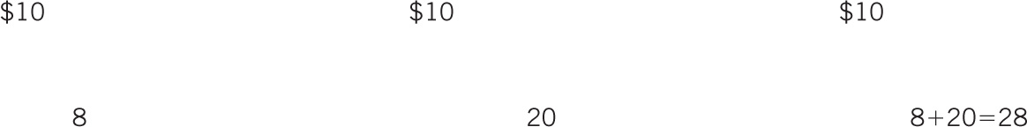


Short-Run Market Supply
Notes:
Image: Animated Figure 9.5
Lecture notes:
The figure starts with MC curves for Mr. Plow and the Plow King. Explain that the market supply curve is the sum (horizontal) of each firm’s supply curve.
At each price, add up the quantity supplied by Mr. Plow and the Plow King.
First click:
At a price of $10, Mr. Plow plows eight driveways.
Second click:
At a price of $10, Plow King plows 20 driveways.
Third click:
So at a price of $10, the two of them together plow 28 driveways.
Fourth click:
Draws out the total supply curve

Slide 37

Signals
Signals convey information about the profitability of various markets.
What happens if existing firms are earning positive or negative profits?
When firms make zero economic profit, the market is in long-run equilibrium.
Notes:
Lecture notes:
Profits act as simple signals telling firms what to do.
For an example of a signal, think of a stoplight.
If firms are earning a positive profit:
Existing firms expand production, and new firms enter.
Additional supply, pushed down price, and profits fall.
If firms are earning a negative profit:
Existing firms cut back on production, and some firms exit.
Less supply leads to higher prices, and losses get smaller.
In the long run, all firms earn zero economic profit.

Slide 38
Practice What You Know—Short Run or Long Run?—1
Short run: clap
Long run: snap
Either/both: stomp your feet
Dave’s Bar & Grill is producing output, but Dave is doing so with a fixed level of capital.
Short run—capital is fixed in the short run
Notes:
Lecture tip: Click to reveal the answer: Short Run

Slide 39
Practice What You Know—Short Run or Long Run?—2
Short run: clap
Long run: snap
Either/both: stomp your feet
Jaime owns a firm in a perfectly competitive industry. She is making positive economic profits.
Short run—in PC industries, profits can be positive in the SR but will be zero in long-run equilibrium
Notes:
Lecture tip: Click to reveal the answer: Short Run

Slide 40
Practice What You Know—Short Run or Long Run?—3
Short run: clap
Long run: snap
Either/both: stomp your feet
Pizza Barn builds a new restaurant.
Long run—changing levels of capital
Notes:
Lecture tip: Click to reveal the answer: Long Run

Slide 41
Practice What You Know—Short Run or Long Run?—4
Short run: clap
Long run: snap
Either/both: stomp your feet
Kyle is producing output and can cover his VC but not his FC expenses.
Short run—in the long run we don’t have FC expenses
Notes:
Lecture tip: Click to reveal the answer: Short Run

Slide 42
Practice What You Know— Short Run or Long Run?—5
Short run: clap
Long run: snap
Either/both: stomp your feet
Eric is a farmer. Given the price of corn, he chooses how much to produce.
Either/both—a profit maximizing firm always will choose the optimal q* output in both the short run and long run
Notes:
Lecture tip: Click to reveal the answer: Either/both long and short run

Slide 43
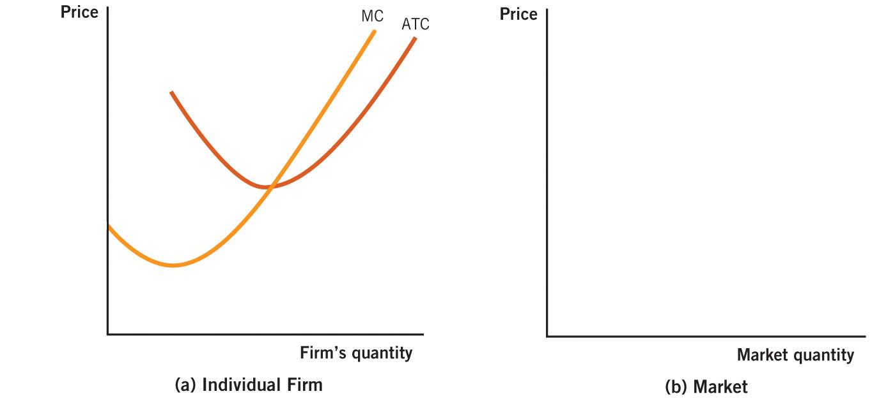
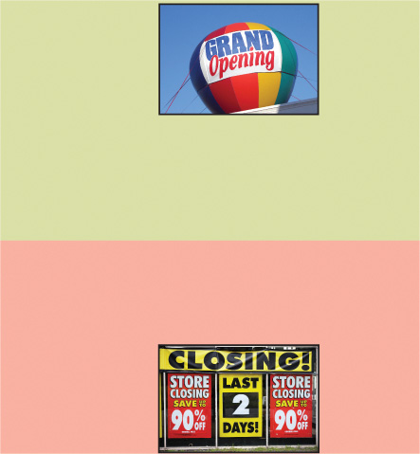
Long-Run Market Supply
Notes:
Image: Animated Figure 9.6
Lecture notes:
The figure starts with a typical firm’s cost curves on the left side, and the market on the right side.
First click:
Draws P = min. ATC
Second click:
To maximize profits, the firm produces where P = MR = MC: Q₁
Third click:
Shades in area above and below min. ATC
At all prices above P, firms will earn a profit (the green shaded area), and at all prices below P, firms will experience a loss (the red shaded area).
Zero economic profit occurs at only one price, and that price is the lowest point of the ATC curve.
Fourth click:
Draws long-run market supply curve
Supply curve in panel (b) must be a horizontal line at P.
If P > min. ATC, firms would enter, supply would increase, and this would force the price back down to P.
If P < min. ATC, firms would exit, supply would decrease, and this would force the price up to P.
Since we know that these adjustments will have time to take place in the long run, the long-run supply curve must also be equal to P in order to satisfy the demand that exists at this price.
[top: © Judy Ledbetter/iStockphoto.com; bottom: © adrian beesley/iStockphoto.com]

Slide 44
A Reminder about Economic Profits—1
Why join an industry if you can’t earn an economic profit in the long run?
When a firm breaks even, they just cover both their explicit costs and implicit costs.
So the firm covers the opportunity costs of their next-best alternative business venture.
Notes:
Lecture notes:
If you run your own business, you are covering:
Opportunity cost of your time:
Salary you could have earned instead of running your own business
Opportunity cost of next best alternative investment.

Slide 45
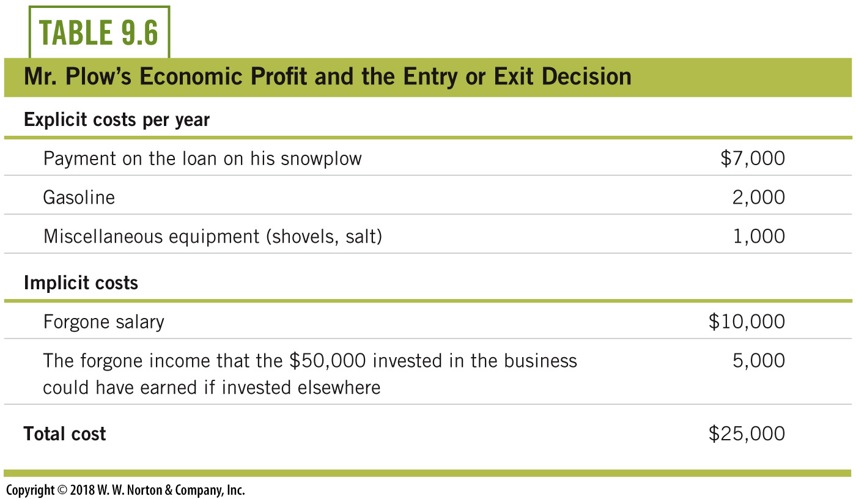
A Reminder about Economic Profits—2
Notes:
Lecture notes:
Mr. Plow has $25,000 in total revenue.
Given $10,000 in explicit costs, Mr. Plow’s accounting profit is $15,000.
But he has $15,000 in implicit costs, which includes his foregone salary and what he could earn if he invested $50,000 elsewhere.
Therefore, his economic profit is zero.

Slide 46
Economics in I Love Lucy, “The Diner”
Ricky and Fred Mertz decide to go into business together and start a diner.
Notes:
“Economics in the Media” Slide
Lecture tip:
The clip mentioned on the slide can be found in the Interactive Instructor’s Guide. Access the direct link by clicking the icon in the PowerPoint above.
The key concepts covered in this slide are:
Competitive markets
Entry and exit
Game theory
Prisoners’ dilemma
You can follow up this clip by asking students the following question:
How do the falling prices described in the clip affect the ability of the firms in the market to make a profit?

Slide 47
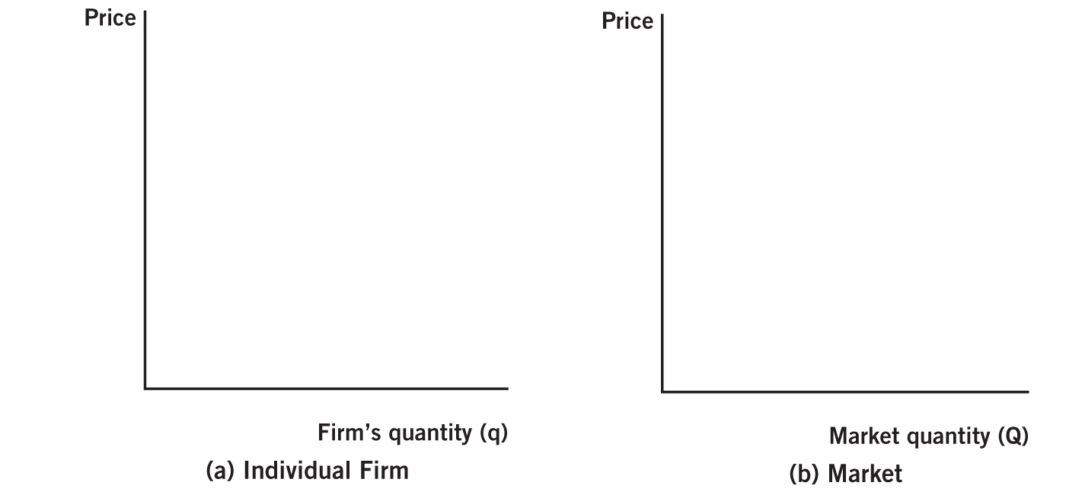
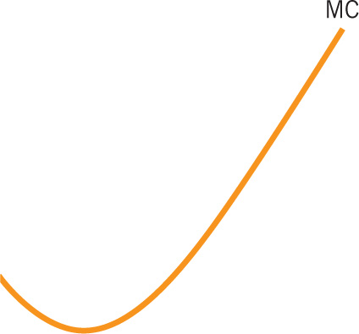
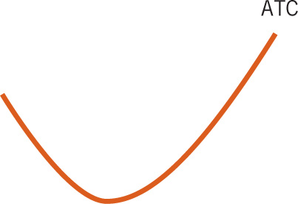

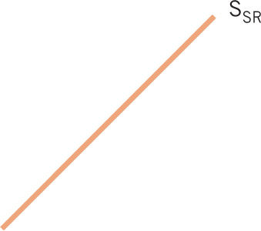
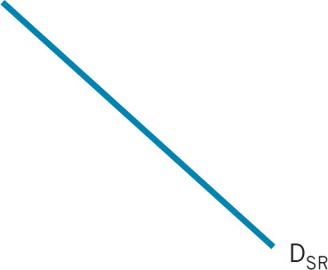
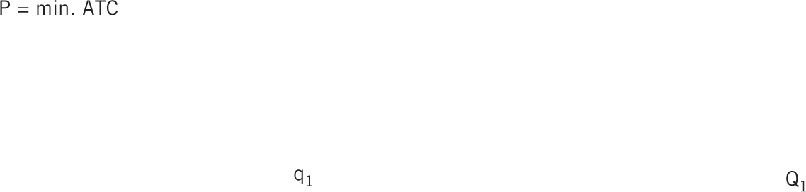

Market in Long-Run Equilibrium
Notes:
Image: Animated Figure 9.7
Lecture notes:
Over the next three slides, we will see how the market adjusts to the long-run equilibrium.
We will start by looking at the firm operating in the long run:
Panel A represents a typical firm in the market.
Panel B depicts the entire market.
First click:
The price in the market occurs where the demand and supply curves intersect.
Second click:
The firm takes this price as given and maximizes profits by producing where P = MC.
This produces q₁.
Since the firm is producing at min ATC, the firm’s economic profit is equal to zero.
Third click:
Total market output is Q₁.
If all the firms are the same, Q₁ = N x q₁.
Fourth click:
In long-run equilibrium, S_{SR} and D_{SR} intersect along S_{LR.}
In this situation, since firms all earn zero economic profit, there is no incentive for firms to enter or exit.
But what would happen if the short-run equilibrium price was above or below S_{LR}?
Fifth click:
If the P > min. ATC, firms earn an economic profit, so new firms would enter.
Sixth click:
If the P < min. ATC, firms earn an economic loss, so firms would exit.

Slide 48
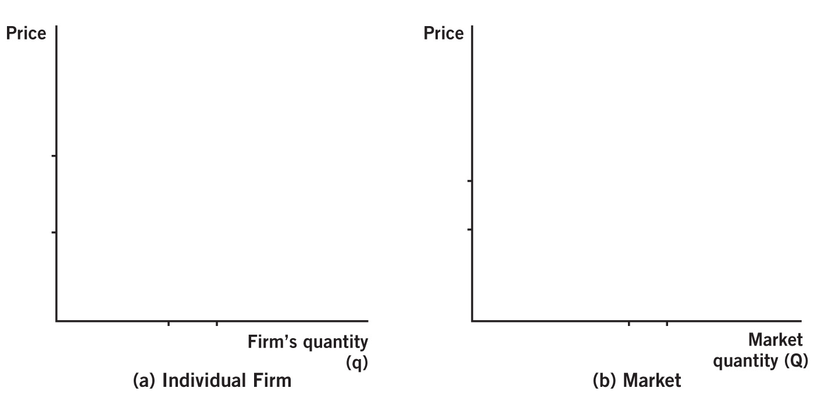
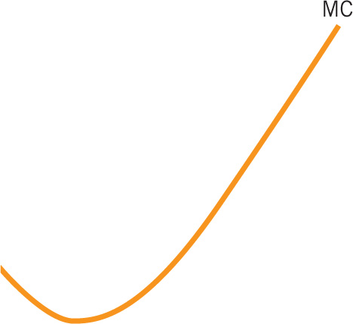
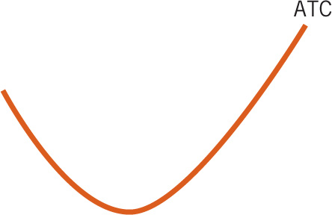
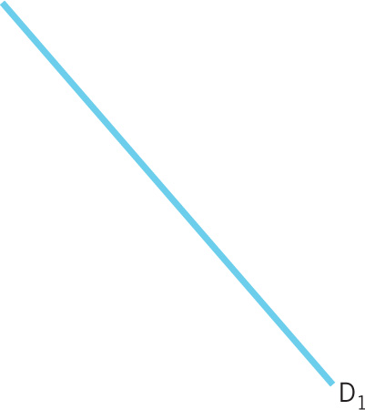
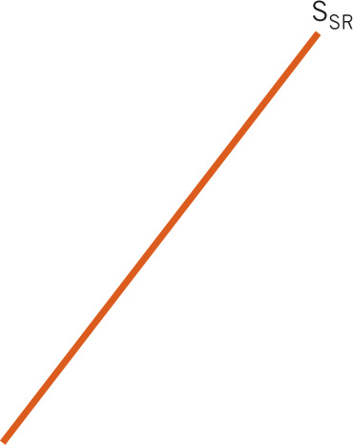
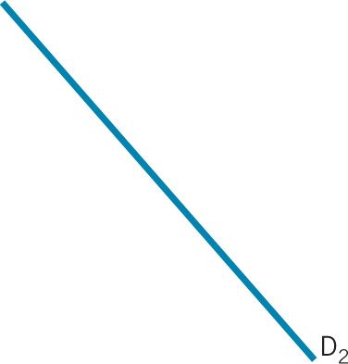
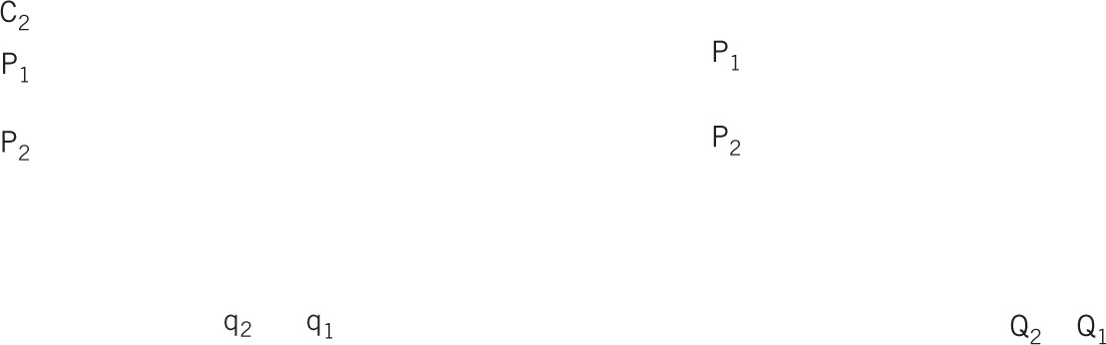

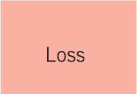


Short-Run Adjustment to Demand Decrease
Notes:
Image: Animated Figure 9.8
Lecture notes:
First click:
The market demand curve shifts from D₁ to D₂.
Second click:
The equilibrium point moves to point B. The price drops to P₂ and the market output drops to Q₂.
Third click:
The firm takes this new price as given, so the new marginal revenue curve is MR₂ at P₂ in panel (a).
Fourth click:
Since the price is lower, the firm will need to reduce output in order to maximize profits.
They now produce q₂.
Ask students, what is the problem for the firm?
Fifth click:
At the new output level, ATC = C₁ > P₂.
The firm earns an economic loss.
Shaded loss

Slide 49
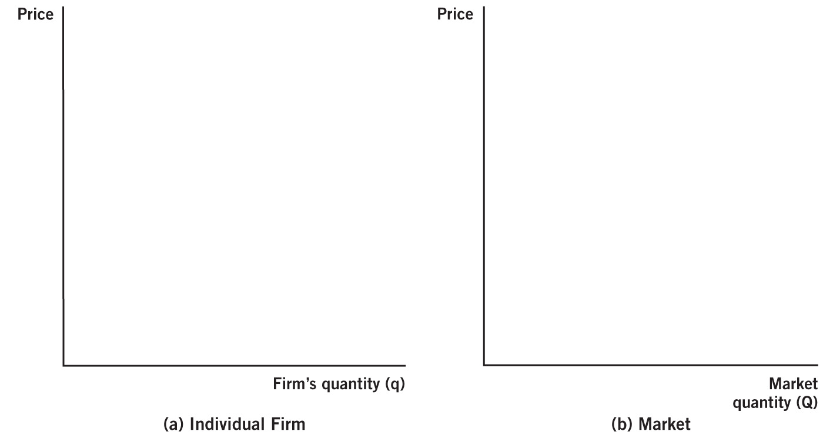
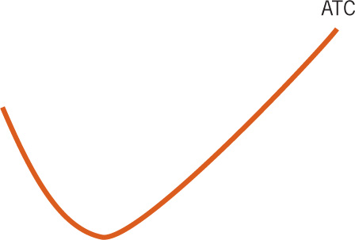
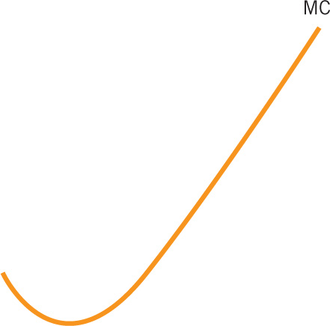

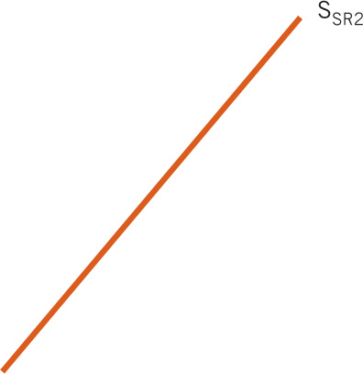
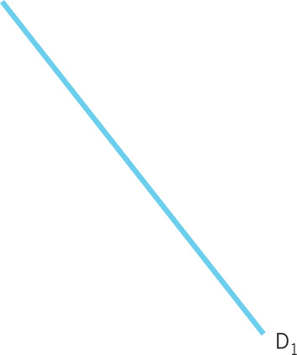
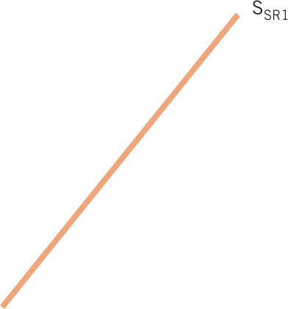







Long-Run Adjustment to Demand Decrease
Notes:
Image: Animated Figure 9.9
Lecture notes:
Since firms earn an economic loss, some firms will exit the industry.
First click:
As firms exit, the supply curve shifts to S_{SR2}.
The new equilibrium is at point C.
Second click:
With less supply, market output falls to Q₃.
And the price increases back to P₁.
Third click:
The firm takes this new price as a given.
And it maximizes profits by increasing output back to q₁.
Once again, the firm’s economic profit is equal to zero.

Slide 50
Adjustment to a Demand Increase—1
Let’s do it with words. Follow along and fill in the blanks.
Suppose the grape market operates in long-run equilibrium. The price is equal to _____, and firms in the market earn an economic profit equal to ______.
Notes:
Lecture notes:
1. P = min. ATC; zero

Slide 51
Adjustment to a Demand Increase—2
A new medical study provides evidence that eating grapes reduces the chance of getting cancer. Therefore, the demand for grapes will ______, and the price of grapes will _____.
Since grape growers now receive a higher price, they will ______ the production of grapes.
Notes:
Lecture notes:
2. increase; increase
3. increase

Slide 52
Adjustment to a Demand Increase—3
In the short run, price is _____ average total cost.
And grape growers in the market make a _____ economic profit.
The economic profits will lead to the _____ of new grape growers.
Notes:
Lecture notes:
4. greater
5. positive
6. entry

Slide 53
Adjustment to a Demand Increase—4
Entry will continue until all grape growers in the market earn an economic profit equal to _____.
Notes:
Lecture notes:
7. zero

Slide 54
Long-Run Supply
We’ve shown a horizontal LR supply curve.
LR supply may be upward-sloping:
  Resources may be limited
  Opportunity costs of labor
Notes:
“Beyond the Book” Slide
At this point, you can discuss the following points (which are not covered in the textbook):
Constant cost industry: Industry long-run supply curve is horizontal.
As the market expands, costs stay the same.
Increasing cost industry: Industry long-run supply curve is upward-sloping.
As the market expands, costs increase.
Decreasing cost industry: Industry long-run supply curve is downward-sloping.
As the market expands, costs decrease.

Slide 55
Practice What You Know—4
If a competitive industry is making positive economic profits, what will eventually happen in this industry?
  The market supply will shift to the left.
  The market supply will shift to the right.
  The market demand will shift to the left.
  The market demand will shift to the right.
Notes:
Clicker question:
Correct answer: B, The market supply will shift to the right.
In a competitive market, positive profits will signal more firms to enter the industry. This will shift market supply to the right. Eventually, the price will fall and profits will return to zero.

Slide 56
Practice What You Know—5
What do you suppose is one of the main reasons that competitive firms all earn zero economic profits in the long run?
  each firm has a lot of market power
  firms all want to earn zero profits
  free entry and exit in the industry
  the cost curves are U-shaped
Notes:
Clicker question:
Correct answer: C, free entry and exit in the industry
Free entry and exit in a competitive industry allows capital to flow where profit is available. In a profitable industry, more firms enter and will erode profits to zero. If new firms could not enter because of entry barriers, existing firms could earn long-run profits.

Slide 57
Practice What You Know—6
In the long run, a firm in a perfectly competitive market earns (more than one answer may apply)
  positive accounting profits.
  zero accounting profits.
  positive economic profits.
  zero economic profits.
Notes:
Clicker question:
Correct answer: A, positive accounting profits, and D, zero economic profits
Why not B and C?
With zero accounting profits, the firm would earn a loss equal to their implicit costs.
If there are positive economic profits, new firms would enter.

Slide 58
Writing to Learn: Write the Rules
For each of the decisions faced by the firm, write the rule that should be followed in mathematical notation and in your own words:
What quantity of output will maximize my profits?
Should I shut down in the short run?
Should I leave this business in the long run?
Will other sellers enter or exit the market?
In the long run what will happen to equilibrium price?
Notes:
Lecture tip:
The Writing to Learn exercise mentioned on the slide can be found in the Interactive Instructor’s Guide (see Tip #336).

Slide 59
Conclusion
In competitive markets, firms have no control over price.
Profits and losses act as signals in a perfectly competitive market.
Competitive markets serve as an ideal benchmark we can compare other market structures to.
Notes:
Lecture tip:
You can conclude this lecture by reiterating the following points:
There is no control over price since there are a large number of firms, each selling identical products
Profits lead to entry; losses lead to exit.
If the market is competitive, social welfare is maximized. You achieve efficiency.
A perfectly competitive market is one in which:
There are large numbers of buyers and sellers producing identical goods.
There is easy entry and exit from the market.
On characteristics of perfectly competitive markets:
We also are assuming perfect information.
You can relate these characteristics of the market structure to firms being price takers.
Ask students what a firm should do if MR > MC or MR < MC. Firms are price takers.
A firm will maximize profit by producing where MR = MC.
In the short run, there are three profitable cases:
P > ATC
Economic profit
P < ATC, but > AVC
Economic loss, but can stay open
P < AVC
Firm should shut down
The long-run adjustment process ensures that firms earn zero economic profit in the long run.

